Slide 1
Total normalized transverse coherence from Young’s double pinhole measurements at FLASH2
07.03.2019

Slide 2
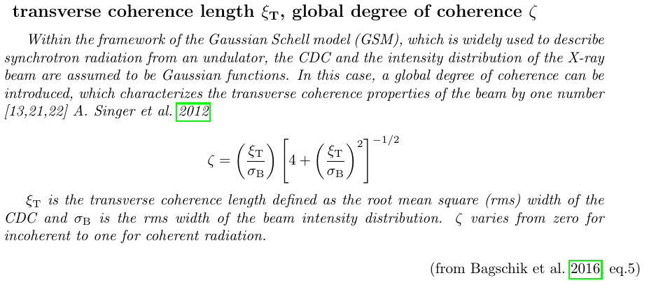
definitions

Slide 3
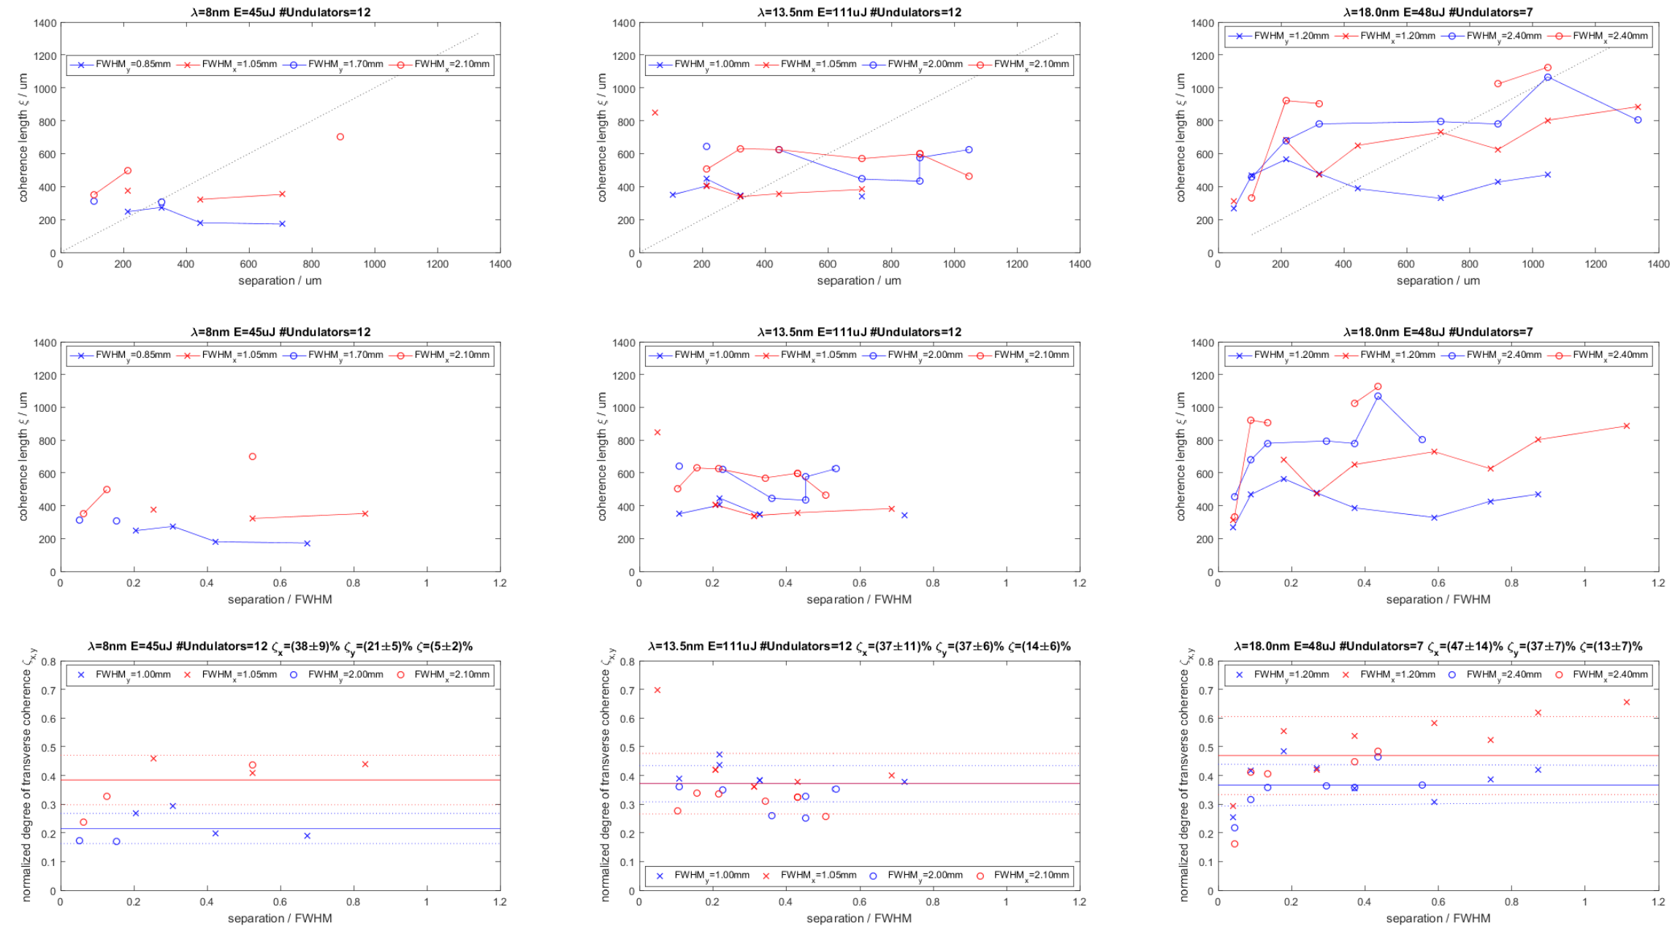



“Coherence length” \xi and “normalized degree of coherence” \zeta vs. slit separation for wavelengths of 8, 13.5 and 18nm

Slide 4
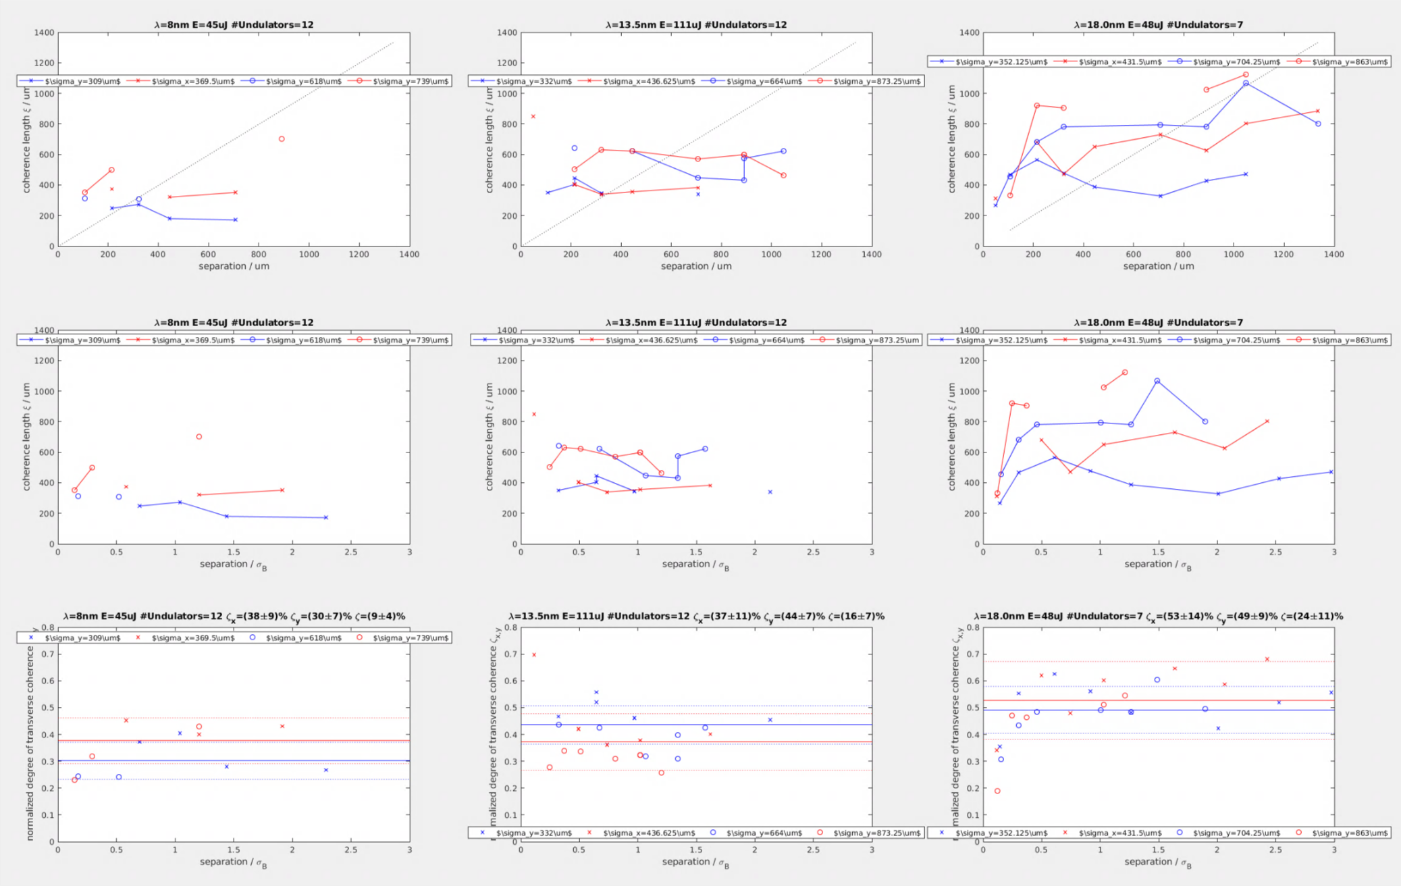
“Coherence length” \xi and “normalized degree of coherence” \zeta vs. slit separation for wavelengths of 8, 13.5 and 18nm
More accurate beam widths

Slide 5
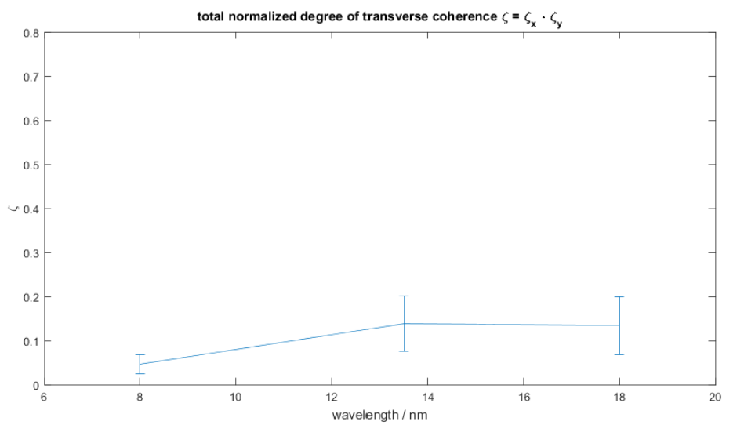
Total normalized degree of coherence vs. wavelength

Slide 6
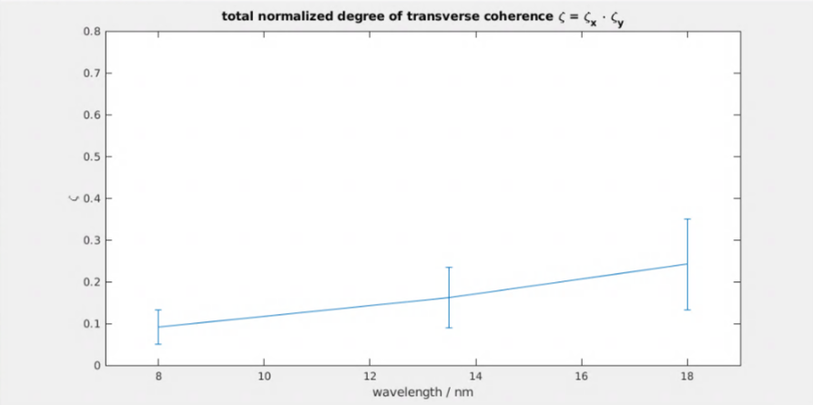
Total normalized degree of coherence vs. wavelength
More accurate beam widths

